Slide 1



Department of Artificial Intelligence & Machine Learning
A Mini Project Presentation
on
“NextGen College Advisor: AI-Powered Guidance for Students”
Presented by
Keerthana S 3BR21AI050
L Sametha 3BR21AI054
Mahesh Ghorpade M 3BR21AI058
Mohammed Muzzakir 3BR21AI067
Under the Guidance of
Dr. B.M Vidyavathi
Guide & Head of the Department
Dept. of AIML
Mr. CTM Praveen Kumar
Project Coordinator
Dept. of AIML

Slide 2
Abstract
Traditionally, students must visit each college's website to gather admission details, which is time-consuming and inefficient.
Concerning that our system uses machine learning models to predict students college admission chances based on their ranks, providing an accurate and reliable platform for admissions predictions.
This approach saves time and enhances the overall efficiency of the college application process.

Slide 3
Contents
Introduction
Literature Survey
Objectives
Problem Statement
Existing systems vs Proposed system
Methodology
Requirements
Design
Implementation
Test cases
Results & Discussion
Conclusion
References

Slide 4

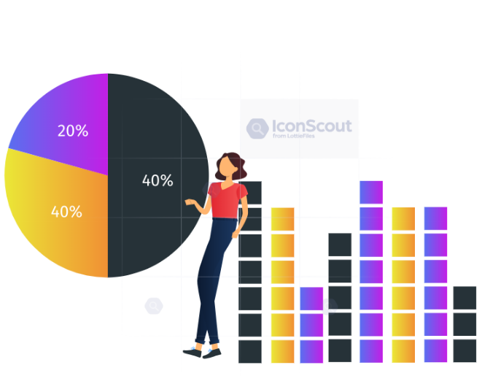

Introduction
Applying to colleges often requires students to visit multiple college websites to gather admission criteria, making the process time-consuming and challenging.
Using Linear Regression method, our system predicts a student's chances of acceptance into various colleges based on their ranks and branch-specific cutoffs.
This platform streamlines the application process, allowing students to make informed decisions and apply to colleges where they have a higher likelihood of acceptance.

Slide 5
Literature Survey
SL.NO | Title | Author | Publication | Findings
[1] | College Recommendation System using Machine Learning | Jadhav Sayali Pramod, Patil Durga Ananda, Kamble Sonali Arun and Shinde Sumit Sahebrao | International Research Journal of Engineering and Technology (IRJET) ,2020 | The methodology involves collecting and preprocessing college data, selecting relevant features, training a C4.5 classifier for predicting admission probabilities, deploying it in a user-friendly web application, and iteratively refining the system based on user feedback to enhance recommendations and usability.
[2] | College Recommendation System Using Artificial Intelligence And Machine Learning | Sunil Sonawane, Madhavi Gosavi, Aparna Pawar and Omkar Pawar | International Research Journal of Modernization in Engineering Technology and Science,2023 | The project provides detailed information about engineering colleges in India, emphasizing factors such as professors, campus life, hostel amenities, and placements, to assist students in making informed decisions based on their CET or diploma final year scores.

Slide 6
SL.NO | Title | Author | Publication | Findings
[3] | AI-driven global talent prediction: Anticipating international graduate admissions | Sachin Bhoitea ,Vikas Magar and C. H. Patil | Department of Computer Science and Application, Dr. Vishwanath Karad , MIT World Peace University, Pune, Maharashtra, India2024 | The methodology involves applying XG Boost to analyze historical admission data from multiple universities globally, assessing the predictive accuracy of academic backgrounds, standardized test scores, English proficiency, and work experience for international graduate program admissions.

Slide 7
Objectives
To provide students with accurate guidance in choosing the right engineering college.
To predict student’s chances of admission into engineering colleges.
To increase time efficiency in the college selection process.

Slide 8
Problem Statement
To Design and develop an AI-driven platform to predict students engineering college admission chances using Linear Regression method.

Slide 9
Existing Systems vs Proposed Systems
Parameter | Existing Systems | Proposed Systems
User Effort | High, users need to do a lot of work themselves | Low, the system does most of the work automatically
Time Efficiency | Manual, time-consuming processes | Faster, automated processes
Prediction | Uses multiple algorithms like Decision Trees and Naive Bayesian | Simplified by using Linear Regression for predictions
Automation | Limited automation, requires a lot of manual work | Highly automated, with much less manual effort

Slide 10


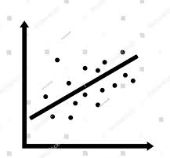

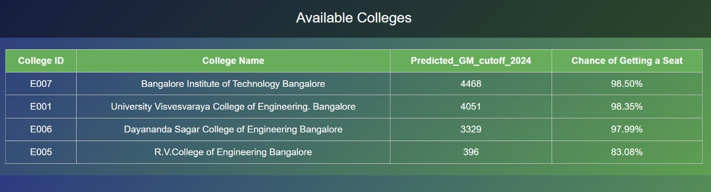
Methodology
Block Diagram:
Entering rank and branch
Linear Regression

Slide 11
Requirements
Functional Requirements:
User Registration and Login
Dashboard
Prediction and Display
Machine Learning Integration
Non-Functional Requirements:
Performance
Scalability
Usability

Slide 12
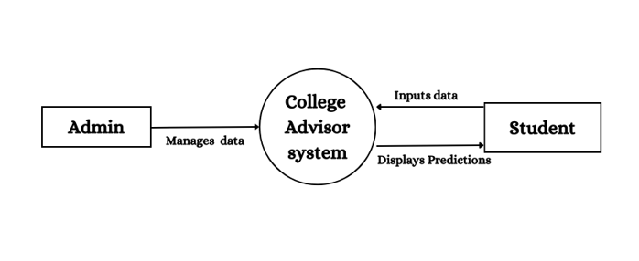
Design
Level 0 data flow diagram:

Slide 13
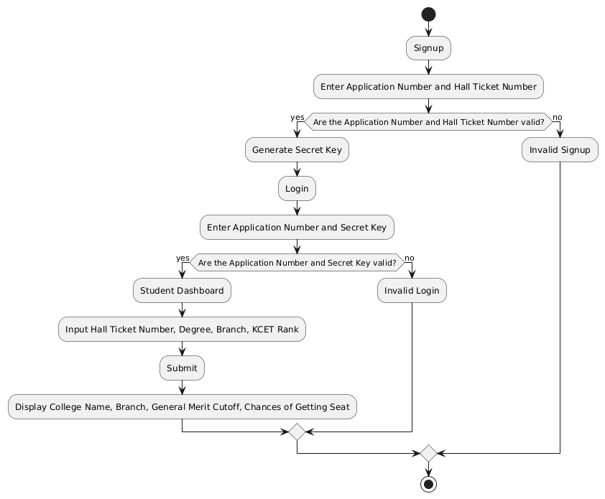
Flowchart:

Slide 14
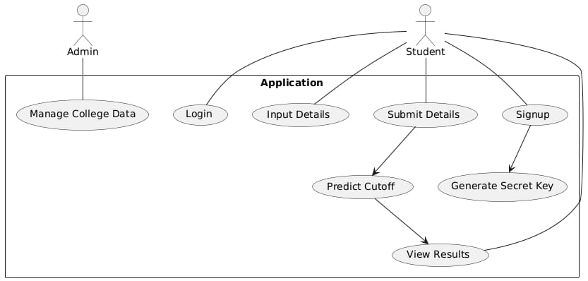
Use case diagram:

Slide 15
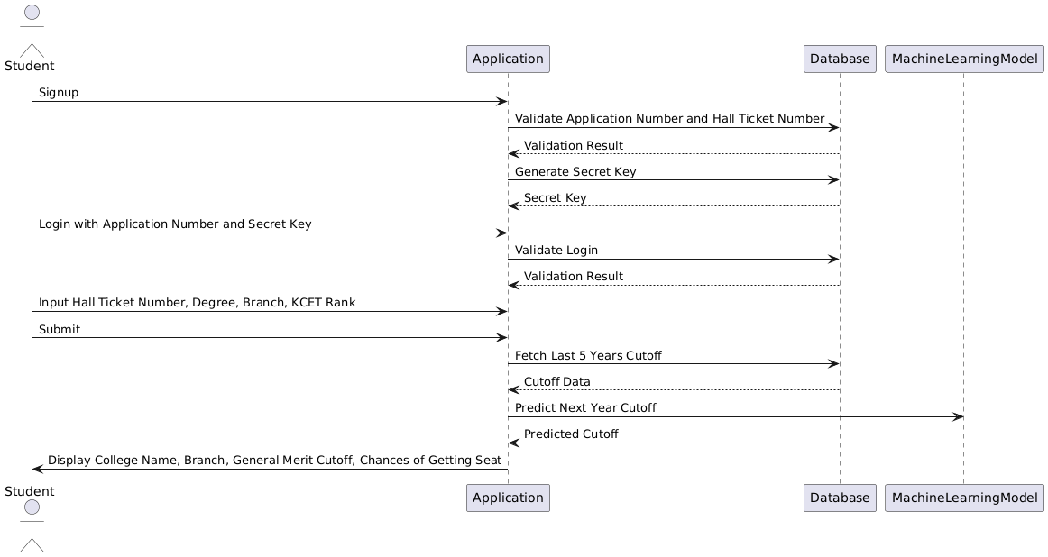
Sequence diagram:

Slide 16
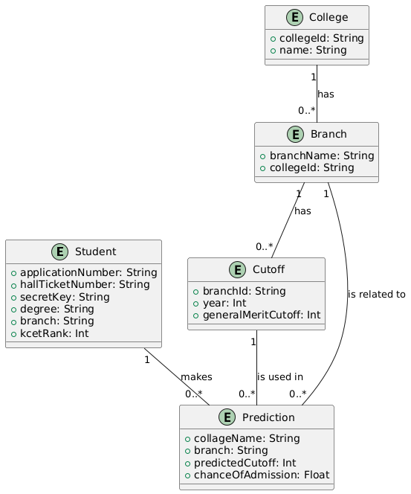
Entity Relationship Diagram:

Slide 17
Implementation
1.Data Collection:
Collect past five years of general merit cutoffs for colleges and branches.
2. Machine Learning Model Development:
Model Selection: Use a linear regression algorithm to predict the admission chances of students.
Training the Model: Train the model using historical cutoff data, adjusting parameters to minimize prediction error.
3.Backend Development:
Database Management: Set up a database to store student information, historical cutoff data, and predicted results.
API Development: Develop APIs to handle user authentication, data submission, and retrieval of prediction results.
Secret Key Generation: Implement a secure method to generate and distribute secret keys for student logins.

Slide 18
4.Frontend Development
User Interface Design: Create an intuitive dashboard where students can input their details and view predictions.
Form Handling: Implement forms for student data submission, ensuring data is validated before processing.
Results Display: Display the predicted colleges, branches, and cutoff scores in a clear and accessible format.
5.Integration and Testing
Integration: Combine the frontend, backend, and machine learning models into a cohesive system.

Slide 19
Test cases
For Sign up:
Test case ID | Test Scenario | Input | Expected Output | Pass/Fail
1.1 | Valid Signup | Valid application number and hall ticket number | User successfully signs up, and a secret key is generated | Pass
1.2 | Invalid Application Number | Invalid application number, valid hall ticket number | Error message indicating the application number does not exist | Pass
1.3 | Invalid Hall Ticket Number | Valid application number, invalid hall ticket number | Error message indicating the hall ticket number does not match | Pass
1.4 | Both Invalid Application and Hall Ticket Numbers | Invalid application number and hall ticket number | Error message indicating both details are incorrect | Pass

Slide 20
For Machine Learning Predictions:
Test case ID | Test Scenario | Input | Expected Output | Pass/Fail
4.1 | Accurate Prediction | KCET rank with historical data available | System accurately predicts the cutoff and chances of admission | Pass
4.2 | Edge Case with Lowest Rank | A very low KCET rank | System predicts low chances of getting into top colleges | Pass
4.3 | Edge Case with Highest Rank | A very high KCET rank | System predicts high chances of getting into multiple colleges | Pass
4.4 | No Historical Data Available | College/branch with no historical data available | Error message or fallback explaining lack of prediction due to no data | Pass

Slide 21
For Login:
Test case ID | Test Scenario | Input | Expected Output | Pass/Fail
2.1 | Valid Login | Correct application number and secret key | User successfully logs in and is redirected to the dashboard | Pass
2.2 | Invalid Password (Secret Key) | Correct application number, incorrect secret key | Error message indicating the password is incorrect | Pass
2.3 | Invalid Application Number | Invalid application number, any password | Error message indicating the application number does not exist | Pass

Slide 22
For Dashboard:
Test case ID | Test Scenario | Input | Expected Output | Pass/Fail
3.1 | Valid Input Submission | Valid hall ticket number, degree, branch, and KCET rank | System displays the predicted college name, branch, cutoff, and chances | Pass
3.2 | Invalid Hall Ticket Number | Invalid hall ticket number, valid degree, branch, and KCET rank | Error message indicating the hall ticket number is invalid | Pass
3.3 | Missing or Empty Input Fields | Missing or empty hall ticket number, degree, branch, or KCET rank | Error message prompting the user to fill in all required fields | Pass

Slide 23
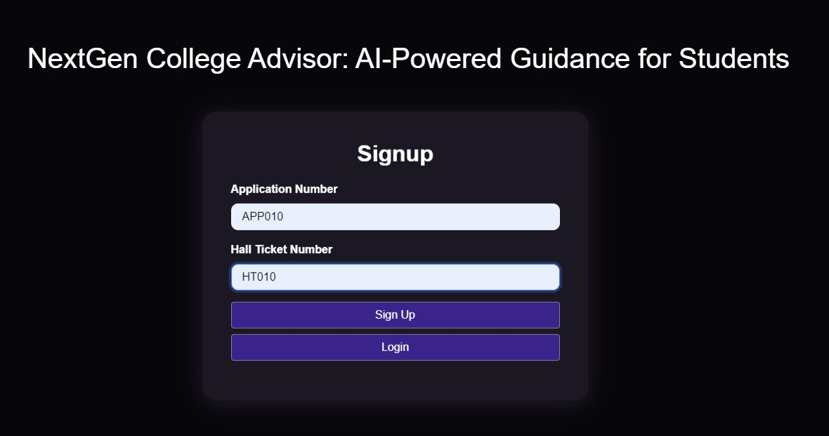
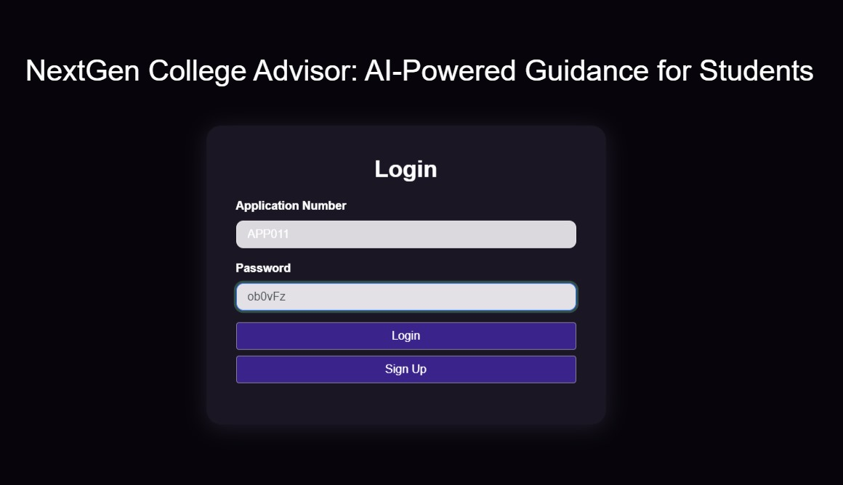
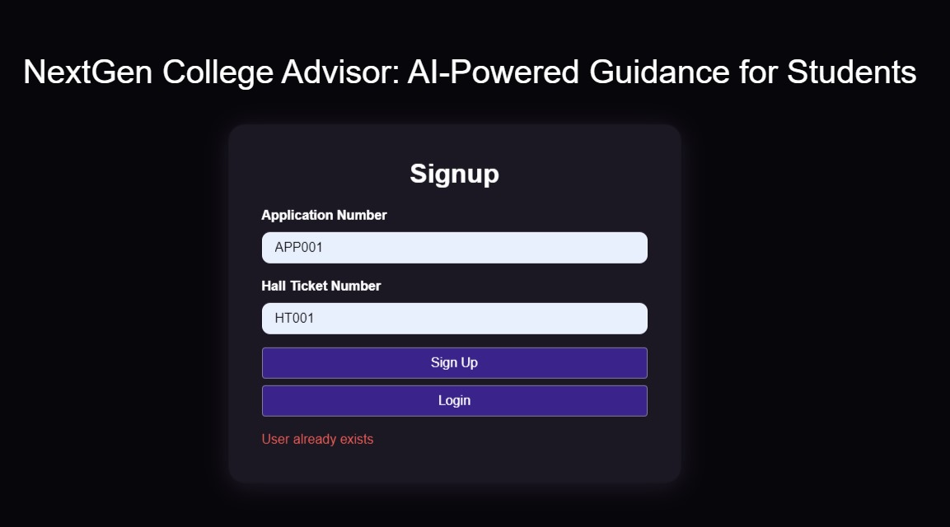
Results & Discussion

Slide 24
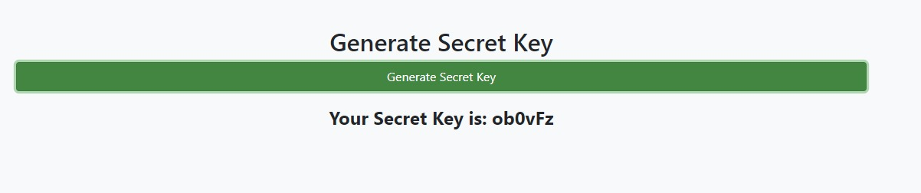
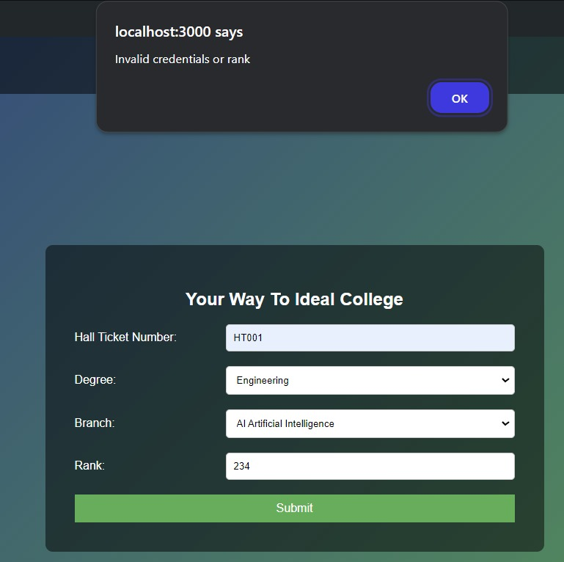

Slide 25
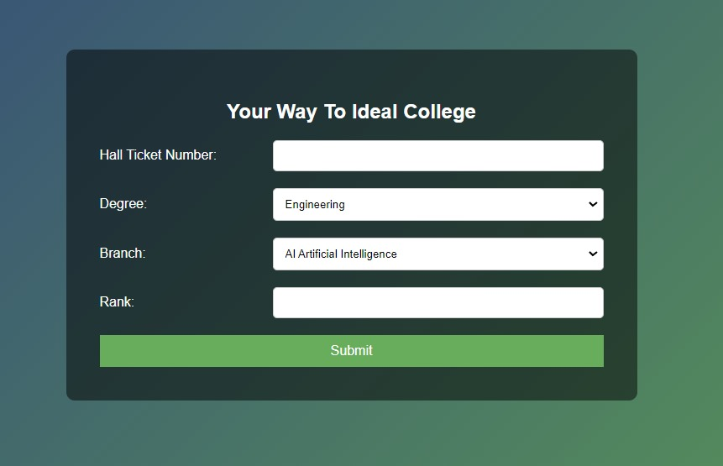
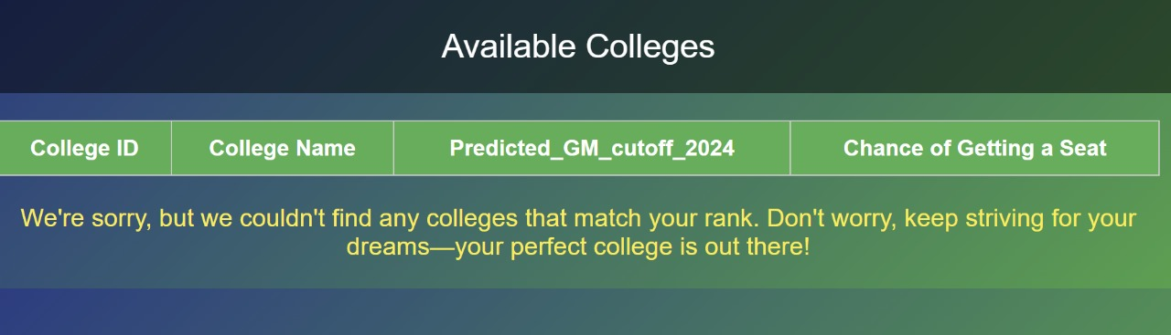

Slide 26
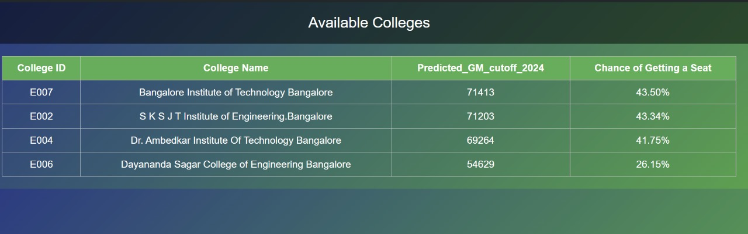
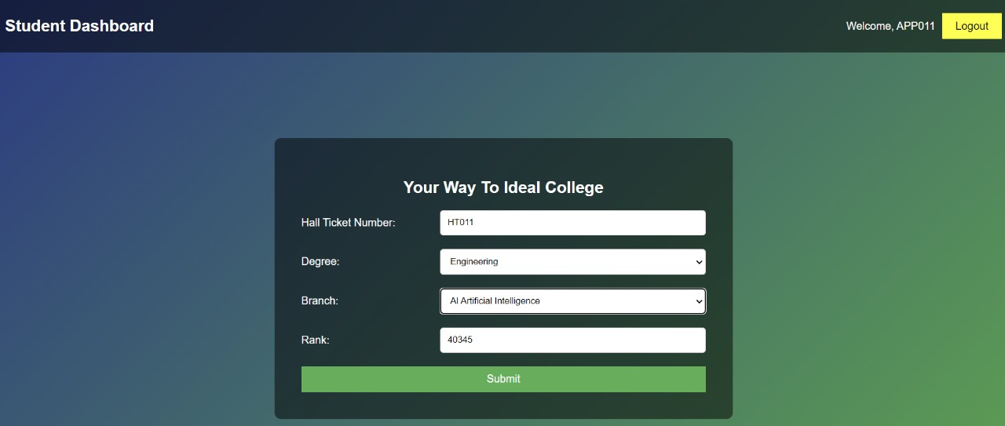

Slide 27
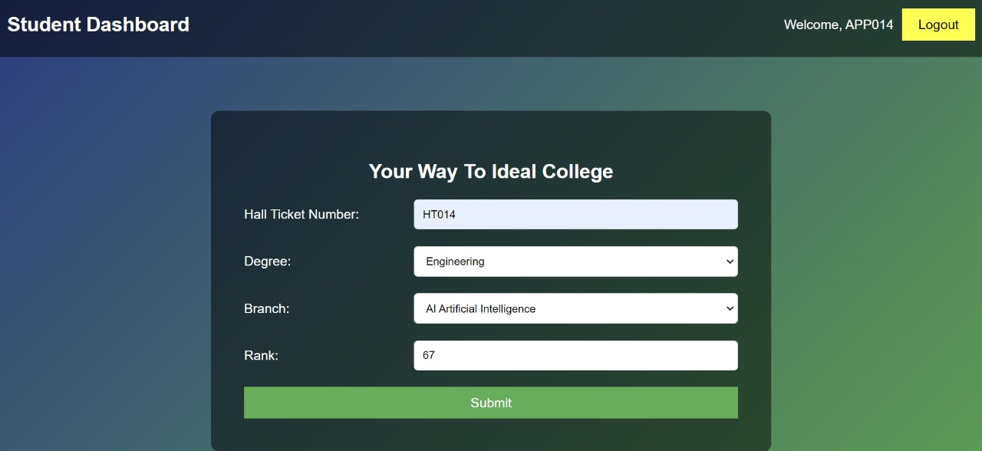

Slide 28
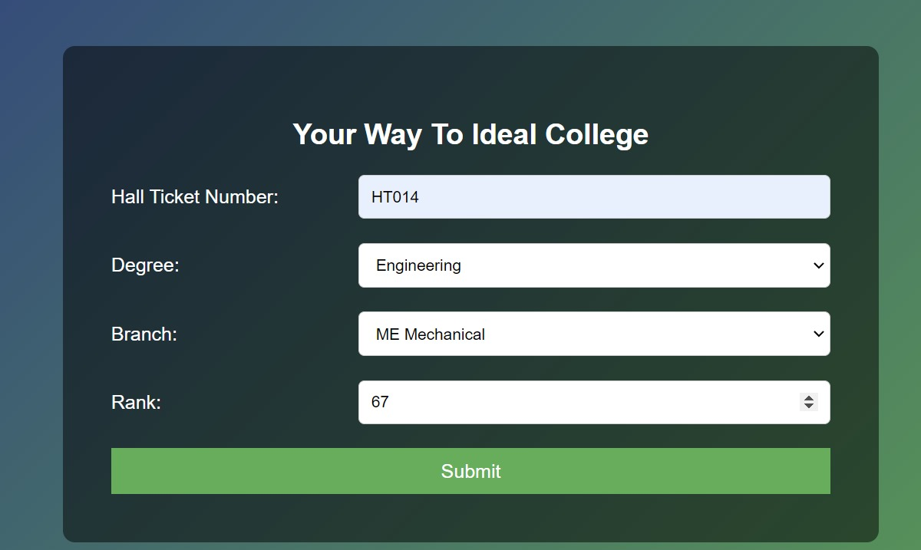
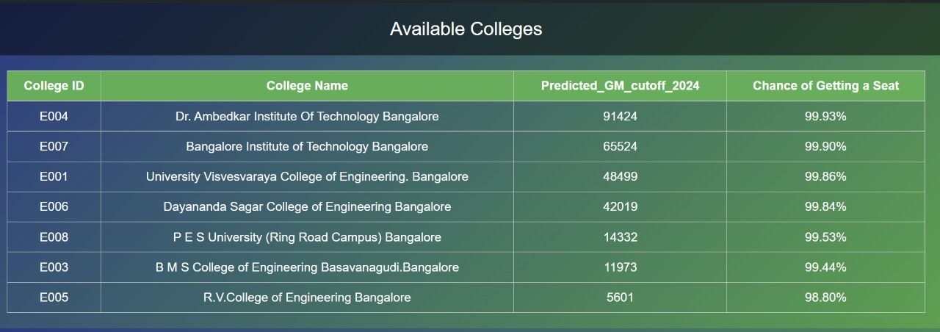

Slide 29

Conclusion
With the increasing complexity of the college admission process, students often struggle to make timely and informed decisions. The 'NextGen College Advisor' addresses this challenge by using Machine learning models to deliver accurate, engineering college admission predictions. This innovative platform not only simplifies the process but also empowers students to navigate their academic futures with confidence and efficiency, showcasing the transformative potential of AI in education.

Slide 30
References
Jadhav Sayali Pramod, Patil Durga Ananda, Kamble Sonali Arun, Shinde Sumit Sahebrao “College Recommendation System using Machine Learning”,2020, e-ISSN: 2395-0056, p-ISSN: 2395-0072
Sunil Sonawane , Madhavi Gosavi , Aparna Pawar, Omkar Pawar and Dhananjay Dighe “College Recommendation System Using Artificial Intelligence And Machine Learning” 2023, e-ISSN: 2582-5208
Sachin Bhoitea ,Vikas Magar and C. H. Patil “AI-driven global talent prediction: Anticipating international graduate admissions”,2024, ISBN :9781003471059
Sommerville, Ian Software engineering / Ian Sommerville. — 9th ed. p. cm. Includes index. ISBN-13: 978-0-13-703515-1 ISBN-10: 0-13-703515-2

Slide 31


